Slide 1
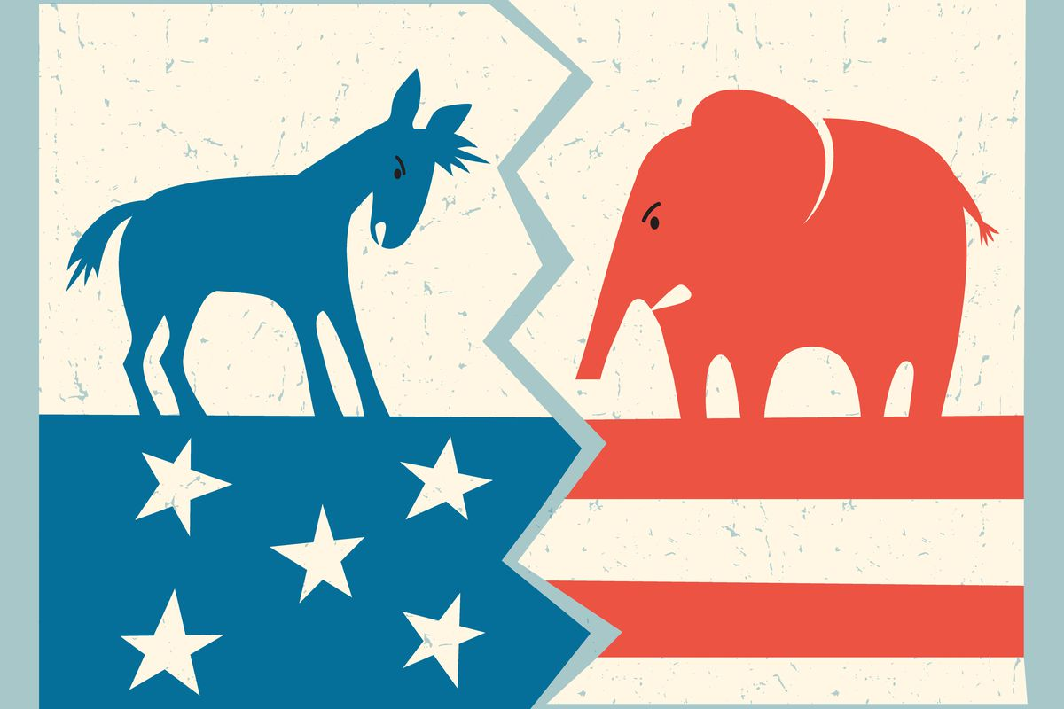
PRESiDENTIAL ELECTION’S Vote
Election Year | Democratic Votes | Republican Votes | WINNER
1856 | 1,836,072 | 1,342,345 | Democratic
1860 | 1,375,157 | 1,866,452 | Republican
1864 | 1,805,237 | 2,218,388 | Republican
1868 | 2,703,249 | 3,013,791 | Republican
1872 | 2,834,761 | 3,598,235 | Republican
1876 | 4,284,020 | 4,036,572 | Republican
1880 | 4,442,035 | 4,454,416 | Republican
1884 | 4,914,482 | 4,856,903 | Democratic
1888 | 5,534,488 | 5,443,892 | Republican
1892 | 5,556,918 | 5,176,108 | Democratic
1896 | 6,509,052 | 7,104,779 | Republican
1900 | 6,358,071 | 7,207,923 | Republican
1904 | 5,083,880 | 7,630,457 | Republican
1908 | 5,079,428 | 7,678,908 | Republican
1912 | 6,293,454 | 3,483,922 | Democratic
1916 | 9,129,606 | 8,547,523 | Democratic
1920 | 9,139,661 | 16,144,093 | Republican
1924 | 8,386,242 | 15,725,016 | Republican
1928 | 15,016,443 | 21,427,123 | Republican
1932 | 22,821,857 | 15,761,254 | Democratic
1936 | 27,751,597 | 16,679,543 | Democratic
1940 | 27,313,945 | 22,347,744 | Democratic
1944 | 25,612,916 | 22,017,929 | Democratic
1948 | 24,179,347 | 21,991,292 | Democratic
1952 | 27,375,090 | 34,075,529 | Republican
1956 | 26,021,440 | 35,579,180 | Republican
1960 | 34,220,984 | 34,108,157 | Democratic
1964 | 43,127,041 | 27,178,188 | Democratic
1968 | 31,271,839 | 31,785,480 | Republican
1972 | 29,173,222 | 47,168,710 | Republican
1976 | 40,831,881 | 39,147,793 | Democratic
1980 | 35,480,115 | 43,903,230 | Republican
1984 | 37,577,352 | 54,455,472 | Republican
1988 | 41,809,074 | 48,886,097 | Republican
1992 | 44,909,806 | 39,104,545 | Democratic
1996 | 47,401,185 | 39,198,755 | Democratic
2000 | 50,999,897 | 50,456,002 | Republican
2004 | 59,028,444 | 62,040,610 | Republican
2008 | 69,498,516 | 59,948,323 | Democratic
2012 | 65,915,795 | 60,933,504 | Democratic
2016 | 65,853,514 | 62,984,828 | Republican
2020 | 81,283,501 | 74,223,958 | Democratic
The historical accumulation of Republican and Democratic Presidential votes (popular votes) in US History 1856 – 2020
By:
Aditya Saini
Gonzalo Ambriz
Adina KesHner

Slide 2

What is the correlation between popular votes and US population?
According to the Census Bureau, The US population has grown steadily in every decade since 1850 with the lowest growth rate being 7.3% between 1930 and 1940. The highest was 21% between 1910 and 1920.
Hypothesis: The popular votes in each presidential race should grow proportionally to the US population, given that the population has increased in every decade since 1850.

Slide 3
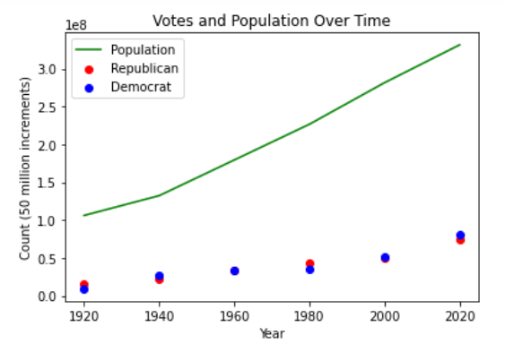
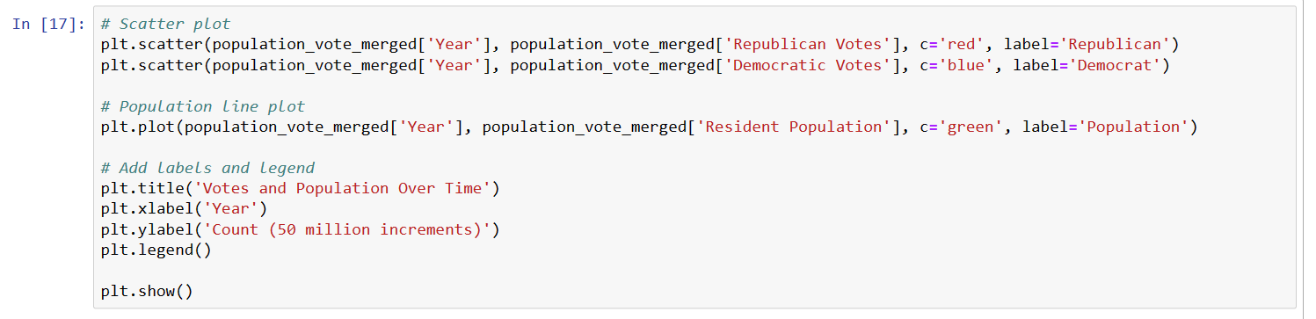

Slide 4
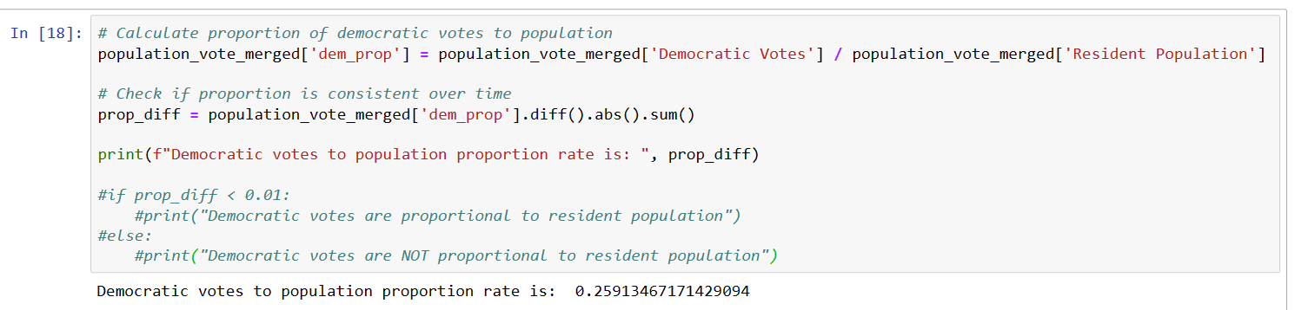
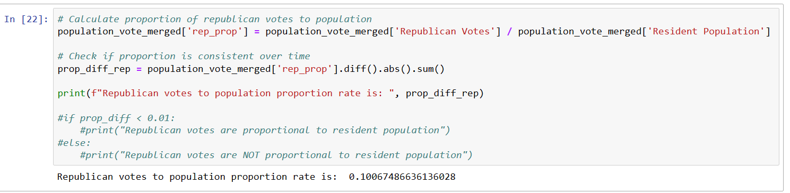
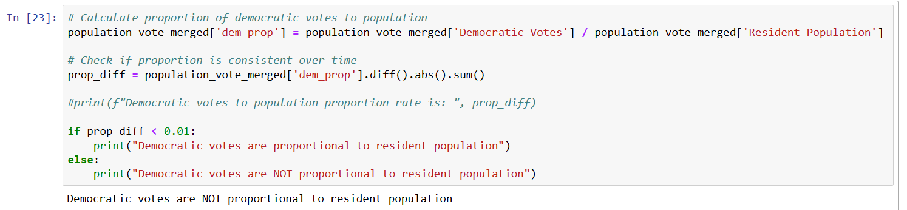
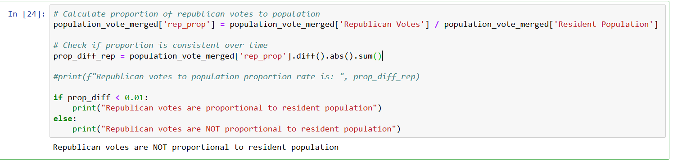
So, does the hypothesis hold true?

Slide 5

How many individuals cast their votes for the Republican and Democratic presidential candidates in each election from 1856 to 2020?
1856-1900:
The Republican Party emerged in the mid-1850s, opposing the expansion of slavery. They lost in 1856 but won with Lincoln in 1860 by 1,866,452 votes and in 1864 by 2,218388 votes.
1901-1950:
Republicans controlled the presidency for most of the early 20th century, except for Wilson [Democrat] in 1912 by 6,293,454 votes and 1916 by 9,129,606 votes and Roosevelt [Democrat] in 1932 (22,821,857 votes) , 1936 (27,751,597 votes) , 1940 (27,313,945 votes), and 1944 (25,612,916 votes).
1951-2000:
This period saw more balanced competition. Notable Democratic wins included Kennedy in 1960, Johnson in 1964, Carter in 1976, and Clinton in 1992 and 1996. Republicans saw victories with Eisenhower in 1952 and 1956, Nixon in 1968 and 1972, Reagan in 1980 and 1984, and Bush in 1988.
2001-2020:
The contests remained close. Republicans won with George W. Bush in 2000 by 50,456,002 votes and 2004 by 62,040,610 votes . Democrats took the presidency with Obama in 2008 by 69,498,516 votes and 2012 by 65,915,795 votes , and Republicans regained it with Trump in 2016 by 62,984,828 votes. Biden [Democrat] won in 2020 by 81,283,501 votes .
HYPOTHESIS:
Null Hypothesis (H0): There is no significant difference in the mean number of votes received by the Republican and Democratic parties from 1856 to 2020.
Alternative Hypothesis (H1): There is a significant difference in the mean number of votes received by the Republican and Democratic parties from 1856 to 2020.

Slide 6
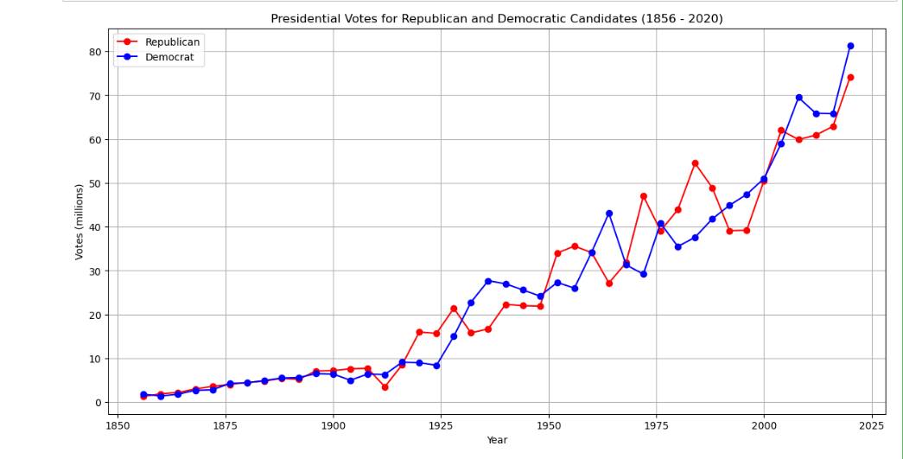
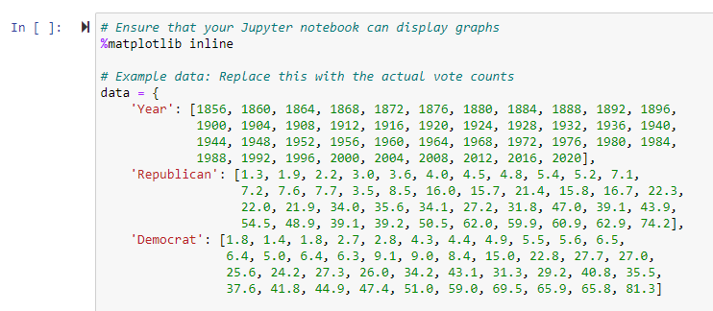
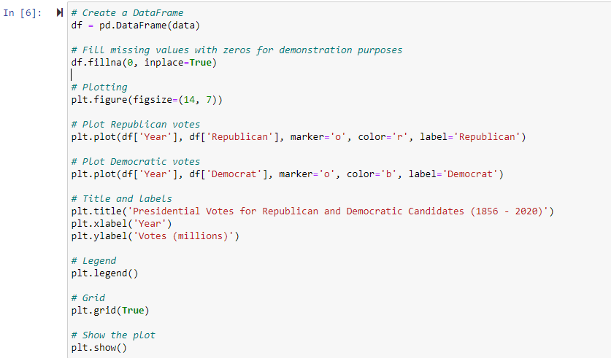
How many individuals cast their votes for the Republican and Democratic presidential candidates in each election from 1856 to 2020?
The line graph is useful for observing the momentum of votes over time, allowing one to see how the popularity of each party has evolved. This graph can help in understanding voting patterns and shifts in the political landscape in the United States over time.
Both Republican and Democratic parties have experienced ups and downs, with some elections showing a clear preference for one party and others being more evenly split.
In the most recent years shown, both parties received a significantly higher number of votes compared to the past, with the counts for both parties reaching or exceeding 60 million votes.

Slide 7
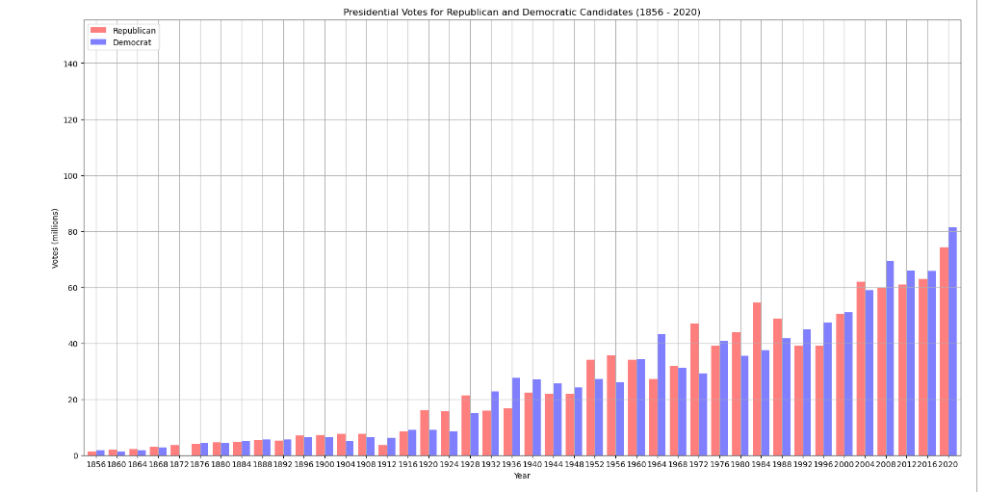
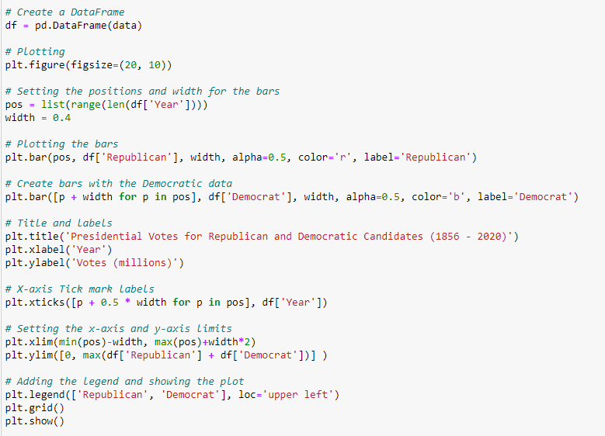
How many individuals cast their votes for the Republican and Democratic presidential candidates in each election from 1856 to 2020?
This bar graph displays the number of votes received by Republican and Democratic candidates in U.S. presidential elections from 1856 to 2020. Each pair of bars represents an election year, with the Republican candidate's votes shown in red and the Democratic candidate's votes in blue.
From the mid-20th century onward, there is a marked increase in the number of votes for both parties. This increase becomes especially steep from the 1950s onwards, likely due to a combination of population growth, the civil rights movement resulting in the Voting Rights Act of 1965.
Over time, the number of votes for both parties shows a general upward trend, reflecting population growth, changes in voter eligibility, and possibly increased political engagement.

Slide 8
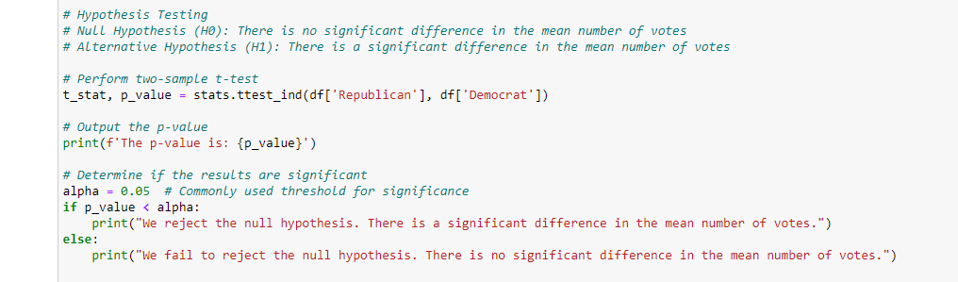
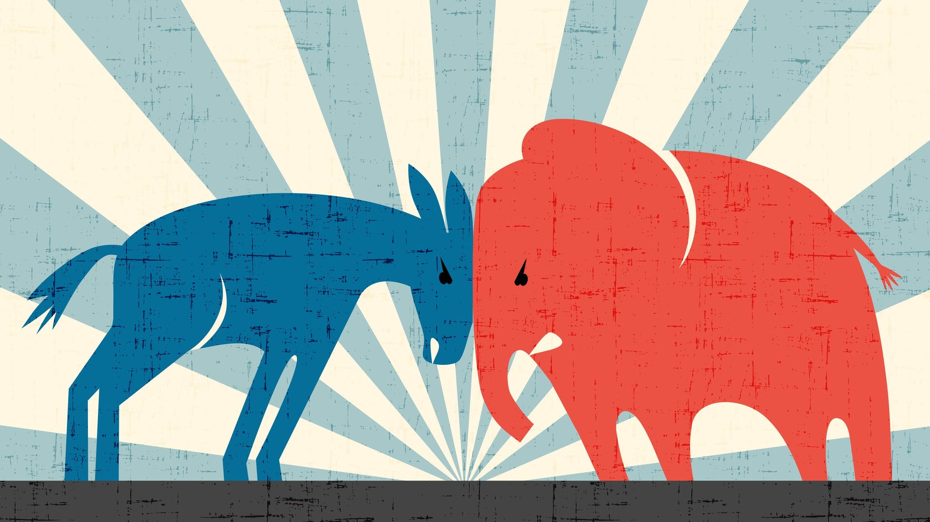
So, does the hypothesis hold true?
The p-value is: 0.9682930895917796 We fail to reject the null hypothesis. There is no significant difference in the mean number of votes.

Slide 9
Did historic shifts in Women’s suffrage change Vote outcome patterns?
Chi square tests were run to test the independence of “Election Year” and “Winner” variables during the historical period before the 19th amendment in 1920, between 1920 and 1976, and since 1980 when women started voting at higher rates than men.
Before women's suffrage:
p-value: 0.38205166150286374
Between 1920 and 1980:
p-value: 0.37815469432346926
After 1980:
p-value: 0.35751800242792586
Findings: There is no statistically significant correlation between these two variables during the historical period before the introduction of women's suffrage, after the beginning of women's suffrage in 1920, and also after 1980 when women started voting at higher rates than men (https://cawp.rutgers.edu/facts/voters/gender-differences-voter-turnout#GGN). Therefore, it can be concluded that the historic demographic shifts in women's electoral participation most likely has not altered the course of national popular vote outcomes for presidential elections. However, it is important to note that this study is limited in that it does not factor in other historical conditions such as war, economics, or abortion rights.

Slide 10
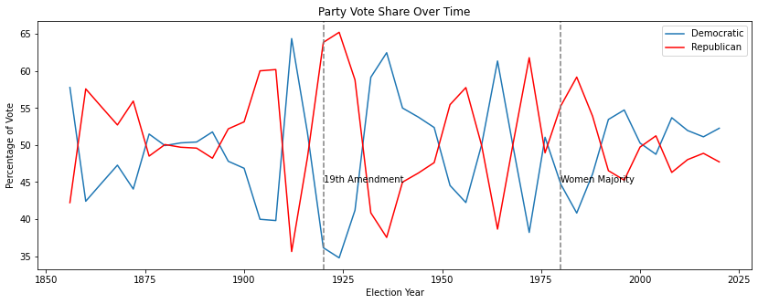
Since the late 1800’s-long before 19th Amendment-American presidential elections have followed a very consistent cycle with neither party able to hold on to dominance for very long. The winner cycles appear to be unaffected by both the entrance of women voters into the electorate, and by their shift into the majority of the electorate. However, it is interesting that Republicans accomplished their historically best performances right after the passage of the 19th Amendment, which also coincides with the end of World War I. It is also interesting that election races have become notably tighter after 1980. Understanding whether this new pattern is due to gender demographic shifts vs. other factors would require more research.

Slide 11
Election Year | Democratic Votes | Republican Votes | WINNER
1856 | 1,836,072 | 1,342,345 | Democratic
1860 | 1,375,157 | 1,866,452 | Republican
1864 | 1,805,237 | 2,218,388 | Republican
1868 | 2,703,249 | 3,013,791 | Republican
1872 | 2,834,761 | 3,598,235 | Republican
1876 | 4,284,020 | 4,036,572 | Republican
1880 | 4,442,035 | 4,454,416 | Republican
1884 | 4,914,482 | 4,856,903 | Democratic
1888 | 5,534,488 | 5,443,892 | Republican
1892 | 5,556,918 | 5,176,108 | Democratic
1896 | 6,509,052 | 7,104,779 | Republican
1900 | 6,358,071 | 7,207,923 | Republican
1904 | 5,083,880 | 7,630,457 | Republican
1908 | 5,079,428 | 7,678,908 | Republican
1912 | 6,293,454 | 3,483,922 | Democratic
1916 | 9,129,606 | 8,547,523 | Democratic
1920 | 9,139,661 | 16,144,093 | Republican
1924 | 8,386,242 | 15,725,016 | Republican
1928 | 15,016,443 | 21,427,123 | Republican
1932 | 22,821,857 | 15,761,254 | Democratic
1936 | 27,751,597 | 16,679,543 | Democratic
1940 | 27,313,945 | 22,347,744 | Democratic
1944 | 25,612,916 | 22,017,929 | Democratic
1948 | 24,179,347 | 21,991,292 | Democratic
1952 | 27,375,090 | 34,075,529 | Republican
1956 | 26,021,440 | 35,579,180 | Republican
1960 | 34,220,984 | 34,108,157 | Democratic
1964 | 43,127,041 | 27,178,188 | Democratic
1968 | 31,271,839 | 31,785,480 | Republican
1972 | 29,173,222 | 47,168,710 | Republican
1976 | 40,831,881 | 39,147,793 | Democratic
1980 | 35,480,115 | 43,903,230 | Republican
1984 | 37,577,352 | 54,455,472 | Republican
1988 | 41,809,074 | 48,886,097 | Republican
1992 | 44,909,806 | 39,104,545 | Democratic
1996 | 47,401,185 | 39,198,755 | Democratic
2000 | 50,999,897 | 50,456,002 | Republican
2004 | 59,028,444 | 62,040,610 | Republican
2008 | 69,498,516 | 59,948,323 | Democratic
2012 | 65,915,795 | 60,933,504 | Democratic
2016 | 65,853,514 | 62,984,828 | Republican
2020 | 81,283,501 | 74,223,958 | Democratic

